Slide 1

Data Structures
Module Number: 2.2
Module Name: Queues
Version: DSA3
Released Date : 2-AUG-2018

Slide 2
Queues
AIM
To understand the basic concept of Queue Data structure

Slide 3
Queues
Objective of This Module
To understand the features of Queue Data Structure
Operations on Queue Data structure
Types of Queues and its operations
Applications of Queue Data Structure

Slide 4
Queues
Expected Outcome
To understand the features of Queue Data Structure
To implement the Operations on Queue Data structure
To understand and implement types of Queues and its operations
Applications of Queue Data Structure

Slide 5
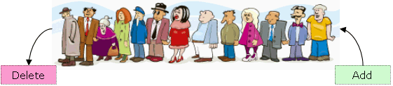
Queues
Queue for Reservation
Figure 2.2.1: Example of Queue
Notes:
In simple language a queue is a simple waiting line which keeps growing if we add the elements to its end and keep shrinking on removal of elements from its front
A queue is a data structure where elements are added at the back and remove elements from the front.
In that way a queue is like “waiting in line”: For example, while we read a book from a file, it is quite natural to store the read words in a queue so that once reading is complete the words are in the order as they appear in the book.

Slide 6
Queues
Queues- Introduction & Definition
It is a linear structure which follows a particular order in which the operations are performed. The order is First In First Out (FIFO).
A good example of queue is any queue of consumers for a resource where the consumer that came first is served first.
The difference between stacks and queues is in removing. In a stack we remove the item the most recently added; in a queue, we remove the item the least recently added.

Slide 7
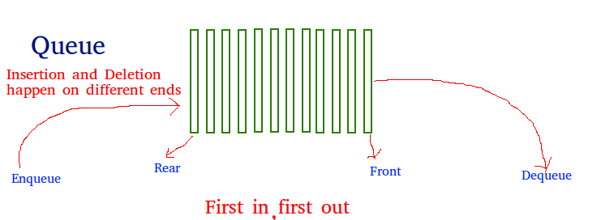
Queues
Representation of Queues
Figure 2.2.2: Queue Representation

Slide 8
Queues
Array Representation- Queues
A queue data structure can be implemented using one dimensional array.
Queue implemented using array can store only fixed number of data values.
To insert a new value into the queue, increment 'rear' value by one and then insert at that position.

Slide 9
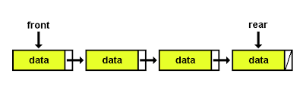
Queues
Linked List Representation
The queue which is implemented using linked list can work for unlimited number of values.
The queue using linked list can work for variable size of data.
The Queue implemented using linked list can organize as many data values as we want.
Figure 2.2.3: Linked List Representation of Queue

Slide 10
Queues
Operations of Queues
Enqueue: Adds an item to the queue.
Dequeue: Removes an item from the queue.
Front: Get the front item from the queue.
Rear: Get the last item from the queue.

Slide 11
Queues
Implementing queues using arrays
Simple implementation
The size of the queue must be determined when a stack object is declared
Space is wasted if we use less elements
We cannot "enqueue" more elements than the array can hold

Slide 12
Queues
Implementing queues using linked lists
Allocate memory for each new element dynamically
Link the queue elements together
Use two pointers, qFront and qRear, to mark the front and rear of the queue

Slide 13
Queues
Queue Implementation Using a Linked List
Internally, the queue is represented as a linked list of nodes, with each node containing a data element.
We need two pointers for the linked list:
A pointer to the beginning of the linked list (front of queue).
A pointer to the end of the linked list (rear of queue).
We will also have a count of the number of items in the queue.

Slide 14
Queues
Linked Implementation of a Queue
A queue q containing four elements
rear
q
front
4
count
Figure 2.2.4: Implementation of Queue using Linked List

Slide 15
Queues
Queue After Adding Element
New element is added in a node at the end of the list, rear points to the new node, and count is incremented.
rear
q
front
5
count
Figure 2.2.5: Showing Enqueue operation on Queue

Slide 16
Queues
Queue After a dequeue Operation
Node is removed from the front of the list (see previous slide), front now points to the node that was formerly second, and count has been decremented.
rear
q
front
4
count
Figure 2.2.6: Showing Dequeue operation on Queue

Slide 17
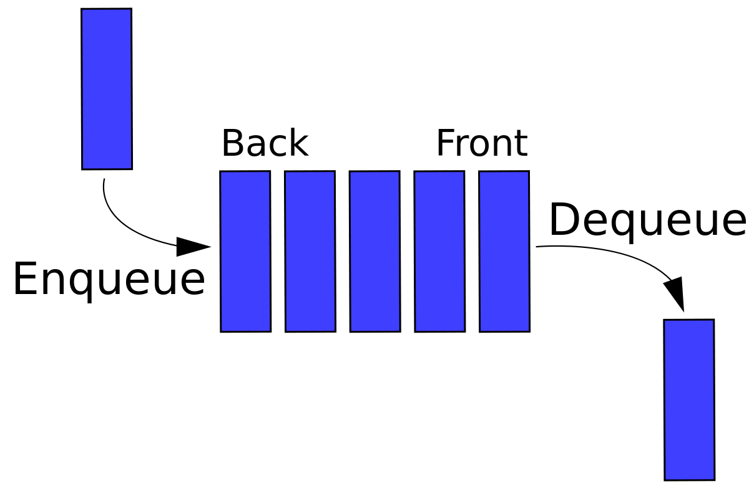
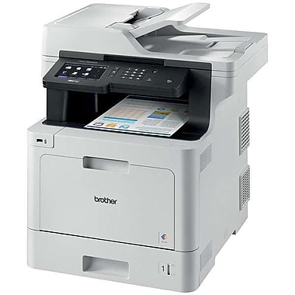
Queues
Queue ADT
Queues implement the FIFO (first-in first-out) policy
An example is the printer/job queue!
Dequeue: Remove From Queue after Job is Completed
Enqueue: Insert in queue when new job arrives
Jobs waiting in Queue in FIFO order to be executed
Figure 2.2.7: Printer Job Queue Example

Slide 18
Queues
Sample Operation
Queue *Q;
enqueue(Q, “a”);
enqueue(Q, “b”);
enqueue(Q, “c”);
d=getFront(Q);
dequeue(Q);
enqueue(Q, “e”);
dequeue(Q);
q
d
front
back
a
b
c
e
Figure 2.2.8: Operations on Queue

Slide 19
Queues
Queue ADT interface
The main functions in the Queue ADT are (Q is the queue)
void enqueue(o, Q) // insert o to back of Q
void dequeue(Q); // remove oldest item
Item getFront(Q); // retrieve oldest item
boolean isEmpty(Q); // checks if Q is empty
boolean isFull(Q); // checks if Q is full
void clear(Q); // make Q empty
}

Slide 20
Queues
Implementation of Queue (Linked List)
Can use Linked List as underlying implementation of Queues
Queue
lst
LinkedList
addTail
head
tail
a₁
a₂
a₃
a₄
Figure 2.2.9: Linked List Representation of Queue

Slide 21
Queues
Code
struct Node { void clear(QUEUE *pQ)
int element; {
Node * next; pQ -> front = NULL;
}; }
struct QUEUE { BOOLEAN isEmpty (QUEUE *pQ)
Node * front; {
Node * rear; return (pQ -> front == NULL);
}; }
Notes:
Node is structure type data structure which will store element and address to next Node
QUEUE is structure type data structure which will maintain front and rear pointers
clear(QUEUE *pQ) method takes address of QUEUE as input and assign NULL value to the front pointer to clear the Queue
isEmpty(QUEUE *pQ) method takes address of Queue as input and check whether QUEUE is Empty or not by checking condition pQ -> front == NULL and returns true or false

Slide 22
Queues
More code
Notes:
The above code is for Dequeue operation:
Dequeue operation: removes the element from the front of the Queue
Method name dequeue(QUEUE *pQ, int *px)
Input: Address of QUEUE structure, and int pointer to hold the address of element removed
Returns: TRUE if element is removed successfully else returns FALSE
Step 1: Check whether the QUEUE is empty by using method isEmpty()
if QUEUE is empty then return false
else go to step 2
Step 2: address of the element at the front Node of Queue is passed to int pointer px;
then go to step 3
Step 3: front pointer is updated by assigning the address of next node
Step 4: After Step 3 completion TRUE is returned

Slide 23
Queues
CELL is a list node
Notes:
The above code is for Enqueue operation:
Enqueue operation: inserts the element at the rear of the Queue
Method name enqueue(int x, QUEUE *pQ)
Input: Address of QUEUE structure, and x element to be inserted
Returns: TRUE if element is insrted successfully else returns FALSE
Step 1: Check whether the QUEUE is empty by using method isEmpty()
if QUEUE is empty
{
then First Node is created by using DMA function malloc and address of Node created is assigned to front pointer of Queue structure
As the Node created is only node in the Queue therefore its address is also assigned to rear pointer
}
else
{
Node is created and its address is assigned to the next pointer of the Node which is currently pointed by rear pointer
rear pointer is updated by assigning the address of Newly created Node
}
Step 2: element is inserted at the element position of Node pointed by rear pointer
Step 3: next pointer of Node at rear is assigned NULL
Step 4: After Step 3 completion TRUE is returned

Slide 24
Queues
Implementation of Queue (Array)
Use Array with front and back pointers as implementation of queue
arr
0
1
2
3
4
5
6
7
8
9
A
B
C
D
E
F
G
back
front
Figure 2.2.10: Array Representation of Queue

Slide 25
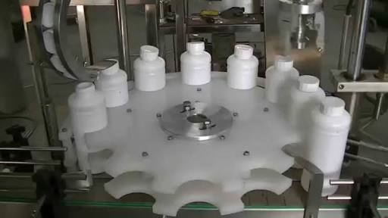
Queues
Circular Queue Example
Figure 2.2.11: Real Life example of circular Queue
Notes:
Circular queue are widely used in computer networks because of its very own circular structure. It is used by network engineers for implementation of round robin algorithm which is used for token passing and also it is used in FIFO buffering systems.
It becomes necessary to check if the queue is not empty or not for dequeue operation which in turn returns an undefined value.
Implementation of Circular Arrays
Consider the positions around the circular arrangement as numbered from zero to max-1, where max is the total number of elements in the circular arrays and to implement circular array consider we use same numbered entries of a linear arrays.
Whenever the index crosses max-1, we start again from 0.

Slide 26
Queues
Circular Array
To implement queue, it is best to view arrays as circular structure.
0
1
2
3
4
5
6
7
8
9
A
B
C
D
E
F
G
back
front
9
0
front
Circular view of arrays.
8
1
A
back
B
C
2
7
G
D
F
E
3
6
5
4
Figure 2.2.12: Representation of Circular Queue implemented using Array

Slide 27
Queues
How to Advance
Insertion operation on Circular Queue (Implemented in C Language)
void insert(int item, int MAX)
{
if(front ==(rear+1)%MAX)
{
printf("\nCircular queue overflow\n");
}
else
{
if(front==-1)
front=rear=0;
else
rear=(rear+1)%MAX;
circleq[rear]=item;
}
}
Notes:
insert function is defined to insert element in the queue.
circleq[] : is array used to implement circular queue
item : is the int type of element to be inserted
MAX : is the size of array used to implement the Queue
Step 1: first step is to check whether the Queue is full or not for this following condition is checked (front == (rear + 1)%MAX)
if Queue is full conditions returns TRUE and message of overflow error is displayed and insert code terminates
else go to step 2
Step 2: if Queue is not full then it is checked that whether queue is empty or not by checking the condition (front== -1)
if Queue is empty then the element to be added is the first element and both front and rear points to same element i.e. front = rear = 0.
then element is added circleq[rear]=item
else goto step 3
Step 3: if Queue is not empty then element is entered using rear pointer
a) rear pointer is incremented by (rear+1)%MAX
b) circleq[rear]=item
Step 4: Stop

Slide 28
Queues
Sample
Queue *Q;
enqueue(Q, “a”);
enqueue(Q, “b”);
enqueue(Q, “c”);
dequeue(Q);
dequeue(Q);
enqueue(Q, “d”);
enqueue(Q, “e”);
dequeue(Q);
Q
a
d
e
b
c
F=front
B=back
F
F
F
F
B
B
B
B
B
B
Figure 2.2.13: Circular Queue operations

Slide 29
Queues
Queue class specification
// forward declaration of NodeType (like function prototype)
template<class ItemType>
struct NodeType;
template<class ItemType>
class QueueType {
public:
QueueType();
~QueueType();
void MakeEmpty();
bool IsEmpty() const;
bool IsFull() const;
void Enqueue(ItemType);
void Dequeue(ItemType&);
private:
NodeType<ItemType>* qFront;
NodeType<ItemType>* qRear;
};
Notes:
//The above code implements Queue ADT using Linked List.
//Code is using C++ Language and use of templates
Class by name QueueType is defined
It contains constructor and destructor
five member functions i.e
MakeEmpty(): this method is used to make queue empty
IsEmpty(): This method checks whether Queue is empty or not and returns TRUE or FALSE
IsFull(): This method checks whether Queue if Full or not and returns TRUE or FALSE
Enqueue(): This method is used to Insert element in the Queue. If Queue is full it gives Overflow error
Dequeue(): This method is used to Remove element in the Queue. If Queue is empty then it gives Underflow error
4. Two data members are used as front and rear pointers of Node type pointer
5. NodeType is structure used for creating nodes

Slide 30
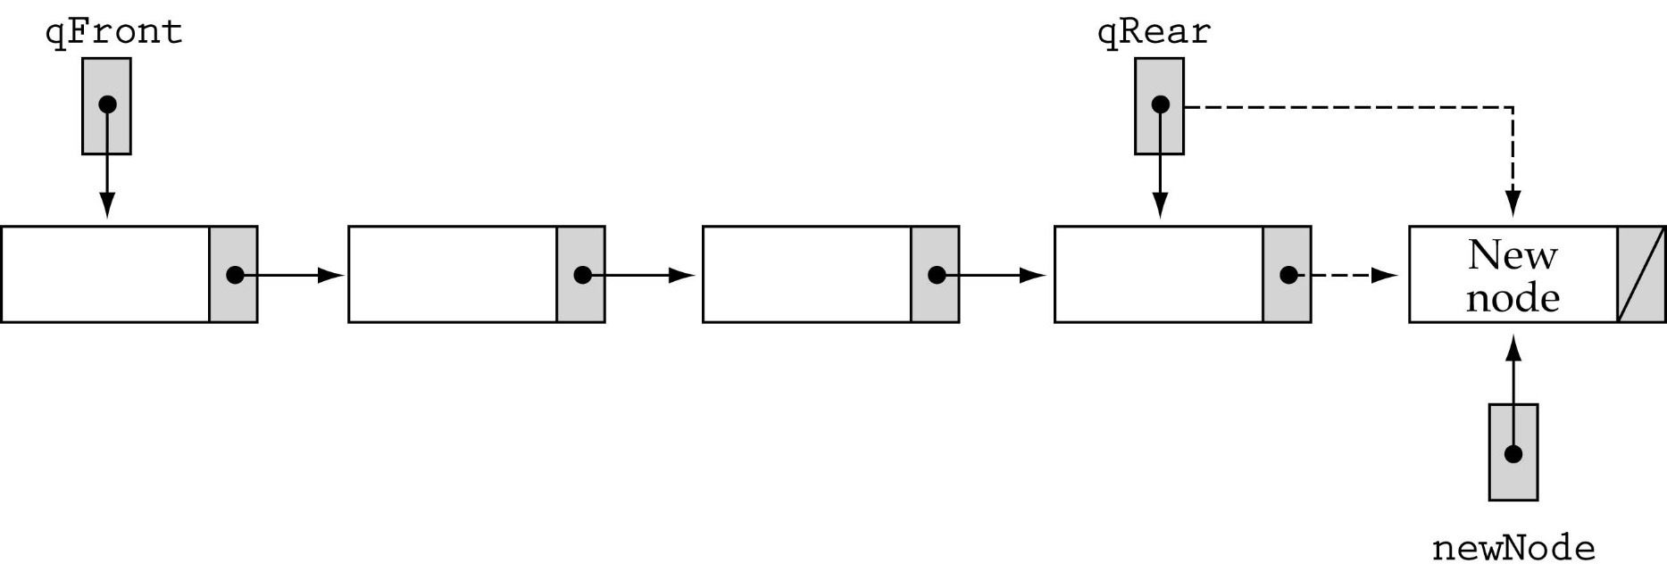
Queues
Enqueuing (non-empty queue)
Figure 2.2.14: Enqueue operation on Queue implemented using Linked List
Notes:
Note: Enqueuing (empty queue)
We also need to make qFront point to the new node.

Slide 31
Queues
Function Enqueue
template <class ItemType>
void QueueType<ItemType>::Enqueue(ItemType newItem)
{ NodeType<ItemType>* newNode;
newNode = new NodeType<ItemType>;
newNode->info = newItem;
newNode->next = NULL;
if(qRear == NULL)
qFront = newNode; else
qRear->next = newNode; qRear = newNode; }

Slide 32
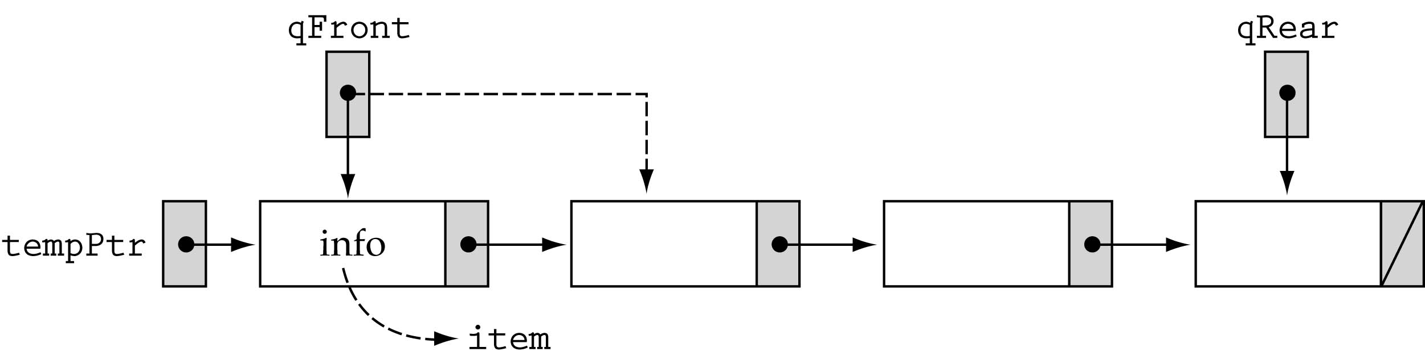
Queues
Dequeueing (the queue contains more than one element)
Figure 2.2.15: Dequeue operation on Queue implemented using Linked List
Notes:
Note: Dequeueing (the queue contains only one element)
We also need to reset qRear to NULL

Slide 33
Queues
Function Dequeue
template <class ItemType>
void QueueType<ItemType>::Dequeue(ItemType& item)
{
NodeType<ItemType>* tempPtr;
tempPtr = qFront;
item = qFront->info;
qFront = qFront->next;
if(qFront == NULL)
qRear = NULL;
delete tempPtr;
}

Slide 34
Queues
Queue (Linear Queue)
It is a linear data structure consisting of list of items.
In queue, data elements are added at one end, called the rear and removed from another end, called the front of the list.
Example:
Queue: AAA, BBB, CCC, DDD, EEE
7
6
EEE
5
1
2
3
4
5
6
7
DDD
4
CCC
3
AAA
BBB
CCC
DDD
EEE
BBB
2
Front
Rear
AAA
1
Figure 2.2.16: Linear Queue

Slide 35
Queues
Algorithms for Insert and Delete Operations in Linear Queue
For Insert Operation
Insert-Queue(Queue, Rear, Front, N, Item)
Here, Queue is the place where to store data. Rear represents the location in which the data element is to be inserted and Front represents the location from which the data element is to be removed. Here N is the maximum size of the Queue and finally, Item is the new item to be added.
1. If Rear = N then Print: Overflow and Return. /*…Queue already filled..*/
2. Set Rear := Rear +1
3. Set Queue[Rear] := Item
4. Return.

Slide 36
Queues
For Delete Operation Delete-Queue(Queue, Front, Rear, Item)
Here, Queue is the place where data are stored. Rear represents the location in which the data element is to be inserted and Front represents the location from which the data element is to be removed. Front element is assigned to Item.
1. If Front = N+1 then Print: Underflow and Return. /*…Queue Empty
2. Set Item := Queue[Front]
3. Set Front := Front + 1
4. Return.

Slide 37
Queues
Example: Consider the following queue (linear queue).
Rear = 4 and Front = 1 and N = 7
10
50
30
40
1
2
3
4
5
6
7
(1) Insert 20. Now Rear = 5 and Front = 1
10
50
30
40
20
1
2
3
4
5
6
7
Figure 2.2.17: Operations on Linear Queue
(2) Delete Front Element. Now Rear = 5 and Front = 2
50
30
40
20
1
2
3
4
5
6
7
(3) Delete Front Element. Now Rear = 5 and Front = 3
30
40
20
1
2
3
4
5
6
7
(4) Insert 60. Now Rear = 6 and Front = 3
30
40
20
60
1
2
3
4
5
6
7

Slide 38
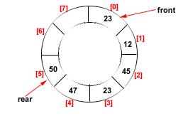
Queues
Drawback of Linear Queue
Once the queue is full, even though few elements from the front are deleted and some occupied space is relieved, it is not possible to add anymore new elements, as the rear has already reached the Queue’s rear most position.
Circular Queue
This queue is not linear but circular.
Its structure can be like the following figure:
In circular queue, once the Queue is full the "First" element of the Queue becomes the "Rear" most element, if and only if the "Front" has moved forward. otherwise it will again be a "Queue overflow" state.
Figure 2.2.18: Circular Queue having rear 5 and front 0

Slide 39
Queues
Algorithms for Insert and Delete Operations in Circular Queue
For Insert Operation Insert-Circular-Q (CQueue, Rear, Front, N, Item)
Here, CQueue is a circular queue where to store data. Rear represents the location in which the data element is to be inserted and Front represents the location from which the data element is to be removed. Here N is the maximum size of CQueue and finally, Item is the new item to be added. Initially Rear = 0 and Front = 0.
1. If Front = 0 and Rear = 0 then Set Front := 1 and go to step 4.
2. If Front =1 and Rear = N or Front = Rear + 1 then Print: “Circular Queue Overflow” and Return.
3. If Rear = N then Set Rear := 1 and go to step 5.
4. Set Rear := Rear + 1
5. Set CQueue [Rear] := Item.
6. Return

Slide 40
Queues
For Delete Operation
Delete-Circular-Q(CQueue, Front, Rear, Item)
Here, CQueue is the place where data are stored. Rear represents the location in which the data element is to be inserted and Front represents the location from which the data element is to be removed. Front element is assigned to Item. Initially, Front = 1.
1. If Front = 0 then
Print: “Circular Queue Underflow” and Return. /*..Delete without Insertion
2. Set Item := CQueue [Front]
3. If Front = N then Set Front = 1 and Return.
4. If Front = Rear then Set Front = 0 and Rear = 0 and Return.
5. Set Front := Front + 1
6. Return.

Slide 41
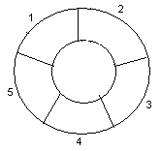
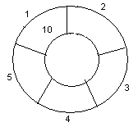
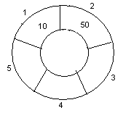
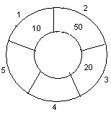
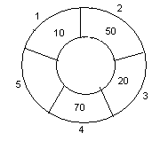
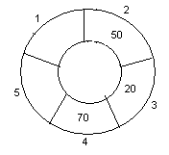
Queues
Example: Consider the following circular queue with N = 5.
1. Initially, Rear = 0, Front = 0.
2. Insert 10, Rear = 1, Front = 1.
3. Insert 50, Rear = 2, Front = 1.
Rear
Front
Rear
Front
4. Insert 20, Rear = 3, Front = 0.
5. Insert 70, Rear = 4, Front = 1.
6. Delete front, Rear = 4, Front = 2.
Front
Front
Front
Rear
Rear
Rear
Figure 2.2.19: Representation of operations on Circular Queue

Slide 42
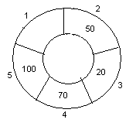
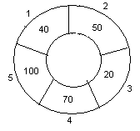
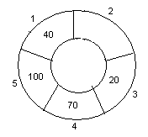
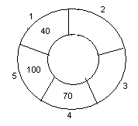
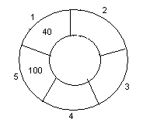
Queues
7. Insert 100, Rear = 5, Front = 2.
8. Insert 40, Rear = 1, Front = 2.
9. Insert 140, Rear = 1, Front = 2.
As Front = Rear + 1, so Queue overflow.
Front
Rear
Front
Rear
Front
Rear
10. Delete front, Rear = 1, Front = 3.
11. Delete front, Rear = 1, Front = 4.
12. Delete front, Rear = 1, Front = 5.
Rear
Rear
Rear
Front
Front
Front
Figure 2.2.20: Representation of operations on Circular Queue

Slide 43

Queues
QUIZ
1) Which one of the following is an application of Queue Data Structure?
a) When a resource is shared among multiple devices
b) Printer jobs waiting to be processed.
c) Buffer used in network communication to store data packets
d) All of the above
2) For every enqueue operation, we __________ by one, and for every dequeue operation, we __________ by one.
a) decrement rear , decrement front b) increment rear, increment front
c) increment front, increment rear d) decrement front, decrement rear
3) For queue implementation, we need two pointers namely front and rear. This pointers are initialized as:
a) front=1 and rear=-1 b) front=-1 and rear=-1
c) front=-1 and rear=1 d) front=1 and rear=1
Notes:
Question No. Answer Key
1 d
2 b
3 b

Slide 44
Queues
QUIZ
4) A circular queue is implemented using an array of size 10. The array index starts with 0, front is 6, and rear is 9. The insertion of next element takes place at the array index.
a) 0 c) 9
b) 7 d) 10
5) If the MAX_SIZE is the size of the array used in the implementation of circular queue, array index start with 0, front point to the first element in the queue, and rear point to the last element in the queue. Which of the following condition specify that circular queue is EMPTY?
a) Front=rear=0 c) Front=rear+1
b) Front= rear=-1 d) Front= (rear+1)%MAX_SIZE
6) A normal queue, if implemented using an array of size MAX_SIZE, gets full when
a) Rear=MAX_SIZE-1 c)Front=rear+1
b) Front= (rear+1)mod MAX_SIZE d)Rear=front
Notes:
Question No. Answer Key
4 a
5 b
6 a

Slide 45
Queues
Types of Queues
Circular Queue – Elements are represented in a circular fashion. Insertion is done at very first location if last location is full.
Double Ended Queue – Elements can be inserted or deleted from both ends.
Priority Queue- Each element is assigned with a priority. An element with highest priority is processed first. Two elements with highest priority is in FIFO order.

Slide 46
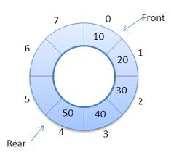
Queues
Circular Queue- Definition
Circular Queue is a linear data structure in which the operations are performed based on FIFO (First In First Out) principle and the last position is connected back to the first position to make a circle. It is also called ‘Ring Buffer’.
Figure 2.2.21: Representation of Circular Queue

Slide 47
Queues
Operations of Circular Queue
Front: Get the front item from queue.
Rear: Get the last item from queue.
enQueue(value) This function is used to insert an element into the circular queue. In a circular queue, the new element is always inserted at Rear position.
Steps:
Check whether queue is Full – Check ((rear == SIZE-1 && front == 0) || (rear == front-1)).
If it is full then display Queue is full. If queue is not full then, check if (rear == SIZE – 1 && front != 0) if it is true then set rear=0 and insert element.
deQueue() This function is used to delete an element from the circular queue. In a circular queue, the element is always deleted from front position.

Slide 48
Queues
Applications of Circular Queue
Memory Management: The unused memory locations in the case of ordinary queues can be utilized in circular queues.
Traffic system: In computer controlled traffic system, circular queues are used to switch on the traffic lights one by one repeatedly as per the time set.
CPU Scheduling: Operating systems often maintain a queue of processes that are ready to execute or that are waiting for a particular event to occur.

Slide 49
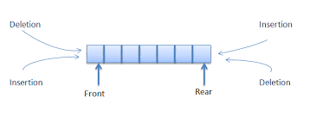
Queues
Dequeue- Definition
Dequeue is a generalized version of Queue data structure that allows insert and delete at both ends.
Figure 2.2.22: Representation of Double Ended Queue

Slide 50
Queues
Operations of Dequeue
insertFront(): Adds an item at the front of Deque.
insertLast(): Adds an item at the rear of Deque.
delete Front(): Deletes an item from front of Deque.
deleteLast(): Deletes an item from rear of Deque.
Following operations are also supported getFront(): Gets the front item from queue. getRear(): Gets the last item from queue. isEmpty(): Checks whether Deque is empty or not. isFull(): Checks whether Deque is full or not.

Slide 51
Queues
Applications of Dequeue
Supports both stack and queue operations, it can do the following:
The De-queue data structure supports clockwise and anticlockwise rotations in O(1) time which can be useful in certain applications.
The problems where elements need to be removed and or added both ends can be efficiently solved using Dequeue.

Slide 52
Queues
Priority Queue- Definition
Priority Queue is an extension of queue with the following properties:
Every item has a priority associated with it.
An element with high priority is dequeued before an element with low priority.
If two elements have the same priority, they are served according to their order in the queue.

Slide 53
Queues
Operations of Priority Queue
insert(item, priority): Inserts an item with given priority.
getHighestPriority(): Returns the highest priority item.
deleteHighestPriority(): Removes the highest priority item.

Slide 54
Queues
Applications of Dequeue
CPU Scheduling
Graph algorithms like Dijkstra’s Shortest Path Algorithm, Prim’s Minimum Spanning Tree, etc.
All queue applications where priority is involved.

Slide 55
Queues
Applications of General Queue
When a resource is shared among multiple consumers.
Examples include CPU scheduling, Disk Scheduling.
When data is transferred asynchronously (data not necessarily received at same rate as sent) between two processes.
Examples include IO Buffers, pipes, file IO, etc.

Slide 56
Queues
Self Assessment Questions
Queue is a …………..Data structure.
FIFO
LIFO
Linear
None of the above
Answer: a)
Notes:
a)

Slide 57
Queues
2. Which Queue data structure allows insertion and deletion at both ends?
Circular
Priority
Dequeue
None of the above
Answer: b)
Notes:
2. b)

Slide 58
Queues
3. In priority queue two elements with same priority is processed…………in order.
LIFO
FIFO
Same order
None of the above
Answer: b)
Notes:
3. b)

Slide 59
Queues
Document Links
TOPICS | URL | Notes
Types of Queue | https://www.tutorialride.com/data-structures/types-of-queue-in-data-structure.htm | This link contains the types of Queue
Operations of Queue | https://www.tutorialspoint.com/data_structures_algorithms/dsa_queue.htm | This link contains the features of queue and operations of queue
Applications of Queue | https://www.geeksforgeeks.org/applications-of-queue-data-structure/ | This link contains applications of Queue

Slide 60
Queues
Video Links
TOPICS | URL | Notes
Queue and its basic operations | https://www.youtube.com/watch?v=XuCbpw6Bj1U | This link contains the queue and its basic operations
Types of queue data structure | https://www.youtube.com/watch?v=xQdoA_7k4I4 | This link contains the Circular Queue
Types of queue data structure | https://www.youtube.com/watch?v=4xLh68qokxQ | This link contains the Dequeue
Applications of Queue | https://www.youtube.com/watch?v=OI_yNQ_QVak | This link contains features, Queue ADT and applications of Queue

